Slide 1
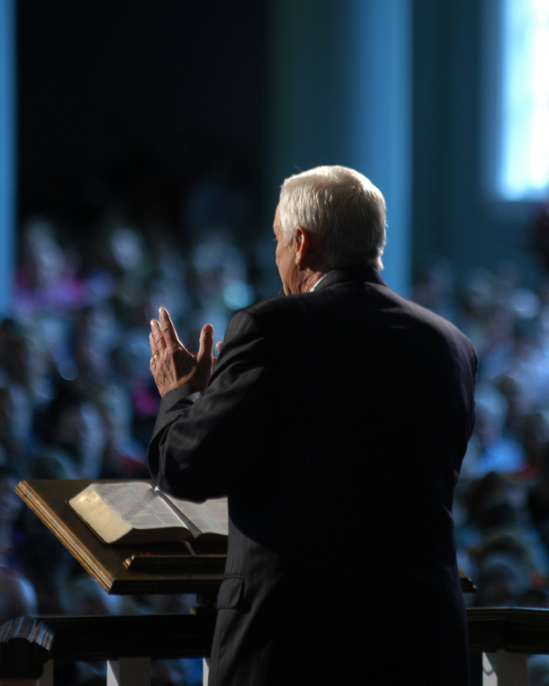
NT Sermon PPT Format
Passage
Dr. Rick Griffith • Crossroads International Church Singapore
BibleStudyDownloads.org

Slide 2
Need

Slide 3
Subject?

Slide 4
Theme
23
TEXT
Book

Slide 5
Let's Study Through Scripture
The Bible: Book by Book

Slide 6
Background

Slide 7
Black on White

Slide 8
I. Main Point

Slide 9
Black on White

Slide 10
"Scripture" (6: NLT).

Slide 11
"Scripture" (6: NLT).

Slide 12
"Scripture" (6: NLT).

Slide 13
"Scripture" (6: NLT).

Slide 14
II. Main Point

Slide 15
"Scripture" (6: NLT).

Slide 16
"Scripture" (6: NLT).

Slide 17
"Scripture" (6: NLT).

Slide 18
"Scripture" (6: NLT).

Slide 19
III. Main Point

Slide 20
Main Idea
Text

Slide 21
Text

Slide 22
Text

Slide 23
Black

Slide 24
NT Preaching • BibleStudyDownloads.org
Get this presentation and script for free!

Slide 25
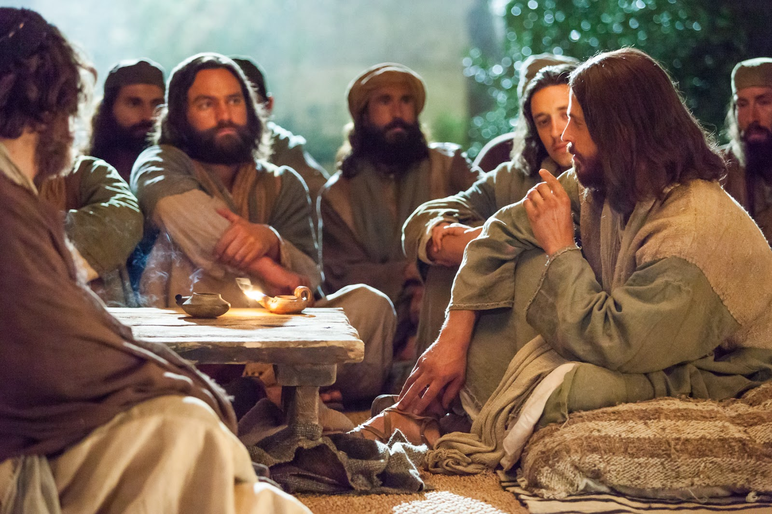
I. Main Point

Slide 26
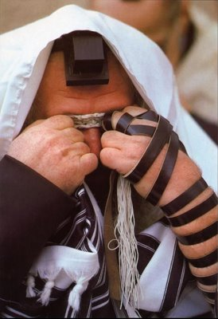
"Scripture" (6: NLT).

Slide 27
UNIQUE MATERIAL…
52
1
MATTHEW
2
MARK
7% unique!
Baptism Lord's Supper
Birth Genealogy
5000 fed Passion
3
LUKE
4
JOHN
92% unique!
16
Notes:
Each of the Gospels say things that the others don't...
//// MATTHEW was believed by the early church to have written first...
//// MARK shares a lot of material with Matthew, such as Christ's baptism and supper...
//// LUKE also has much overlap with Matthew and Mark, such as Christ's baptism and supper—but only Matthew and Luke record Christ's birth and genealogy. However, the fourth…
//// JOHN, stands alone in terms of its material. Only 8% of it repeats stories from the others—such as the feeding of the 5000, and, of course, His death and resurrection.
//// But the remaining 91% of JOHN you will find only in JOHN.

Slide 28
When I Think They Were Written…
52
1
MATTHEW
2
MARK
TO:
JEWS
TO:
ROMANS
The A.D.40s
A.D. 64-68
AS:
KING
AS:
SERVANT
WHAT
HE:
WHAT
HE:
SAID
DID
3
LUKE
4
JOHN
GREEKS
CHURCH
A.D. 57-59
A.D. 69 AFTER THE SYNOPTICS
TO:
TO:
AS:
GOD/MAN
AS:
GOD
WHAT
HE:
WHAT
HE:
FELT
MEANT
27
4
Notes:
Now…what about the dates of the writing of these crucial documents? And here we are left to our best scholarly guesses. There will ALWAYS be argument here. But some of the best guesses, based on decades of academic research and study are these – in suggested order…
//// MATTHEW…composed sometime during the A.D. 40s…
//// LUKE is suggested as next, between the years A.D. 57 and 59 A.D…
//// Mark…in the next decade…between 64 and 68…
//// and finally…John’s Gospel…around A.D. 69….but certainly after the Synoptics were set down. Again, you will always find disagreement on these dates. However, these dates are from the research of well-known Christian scholars and teachers.

Slide 29
Chronology of Jesus & Acts
38a
5/4 BC
1 BC
AD 1
14
29
30
33
35
Jesus Born
–1 year–
Tiberius Crowned
15th Yr. Tiberius
– John & Jesus
Jesus Died
Paul Believed
“In the 15th year of Tiberius… John preached” (Luke 3:1)
32-33 years
“Now Jesus himself was about 30 years old when he began his ministry” (Luke 3:23)

Slide 30
NT Overview (Paul's Letters)
38 124 39-41
“To the remotest part of the earth” (Acts 1:8)
Acts 9 13 14 15 16 18 21 27 28
Apr 48- Sep 49
1 Galatia
Apr 50- Sep 52
2 Aegean
Spr 53- May 57
3 Asia
Feb 60- Mar 62
1 Rome
Spr 62- Fall 67
4 Spain
Aut 67- Spr 68
2 Rome
Summer 35- 37
Damascus Antioch
May 57- Aug 59
Trials
Fall 49
The
Council
Spring 68
Expansion of Church
35 48 49 50 52 53 57 60 62 67 68 95
Matt
Luke
Acts
Mark
John
Gal
1 Thess
1 Cor
Eph
1 Tim
2 Tim
2 Thess
2 Cor
Col
Titus
Missionary
Pastoral
Romans
Philem
Gospels & Acts
Phil
Pauline Epistles
1234
Journeys
Prison
Rome
Imprisonments
Pauline
Notes:
Observations about chronology:
Gospels not written first but throughout NT era
Evangelistic letters preceded pastoral
Rough letter (Galatians) preceded smoother ones

Slide 31
Black on White

Slide 32
"Scripture" (6: NLT).

Slide 33
"Scripture" (6: NLT).

Slide 34
"Scripture" (6: NLT).

Slide 35
"Scripture" (6: NLT).

Slide 36
"Scripture" (6: NLT).

Slide 37
"Scripture" (6: NLT).

Slide 38
Black on White

Slide 39
I. Main Point

Slide 40
"Scripture" (6: NLT).

Slide 41
"Scripture" (6: NLT).

Slide 42
"Scripture" (6: NLT).

Slide 43
"Scripture" (6: NLT).

Slide 44
Black on White

Slide 45
"Scripture" (6: NLT).

Slide 46
"Scripture" (6: NLT).

Slide 47
"Scripture" (6: NLT).

Slide 48
"Scripture" (6: NLT).

Slide 49
Black on White

Slide 50
I. Main Point

Slide 51
"Scripture" (6: NLT).

Slide 52
"Scripture" (6: NLT).

Slide 53
"Scripture" (6: NLT).

Slide 54
"Scripture" (6: NLT).

Slide 55
Entering the Kingdom of Heaven

Slide 56
Title
Explanation

Slide 57
Blue Background
EXILES
WORSHIPPERS
INTO

Slide 58
Blue Background
LIVE WELL
LAUGH OFTEN
LOVE MUCH

Slide 59
Blue Background
LIVE WELL
LAUGH OFTEN
LOVE MUCH

Slide 60
Blue Background
1
2
3
4

Slide 61
Black Text
Website

Slide 62
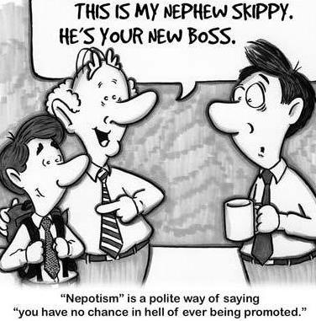
Nephew
This is my nephew, Skippy. He's your new boss.

Slide 63
Black Text
Website

Slide 64
Title

Slide 65
Title

Slide 66
Black

Slide 67
Black

Slide 68
NT Preaching • BibleStudyDownloads.org
Get this presentation and script for free!

